Slide 1

Money and Business Cycles I:
The Price-Misperceptions Model

Slide 2
Effects of Money in the Equilibrium Business-Cycle Model
(复习)

Slide 3
Effects of Money in the Equilibrium Business-Cycle Model
In our equilibrium business-cycle model, technology shocks, A, affect the real quantity of money demanded, L(Y, i) via real GDP, Y, and the nominal interest rate, i, in opposite directions.

Slide 4
Effects of Money in the Equilibrium Business-Cycle Model
If the nominal quantity of money supply, M, does not respond to changes in the real quantity of money demanded, the price level, P, will move in the direction opposite to the change in L(Y, i).
Therefore, the model predicts that P would be countercyclical—low in booms and high in recessions

Slide 5
Effects of Money in the Equilibrium Business-Cycle Model
If the monetary authority wants to stabilize the price level, P, it should adjust the nominal quantity of money supply, M, to balance the changes in the real quantity of money demanded, L(Y, i).
In this case, M will be procyclical.

Slide 6
The Price-Misperceptions Model

Slide 7
The Price-Misperceptions Model
Empirical evidence suggests that money is not as neutral as predicted by our equilibrium business-cycle model.
The price-misperceptions model provides a possible explanation for the non-neutrality of money.
Households sometimes mis-interpret changes in nominal prices & nominal wage rates as changes in relative prices & real wage rates.

Slide 8
The Price-Misperceptions Model
A Model with Non-Neutral Effects of Money
  The important difference from before is that households have incomplete current information about prices in the economy.

Slide 9
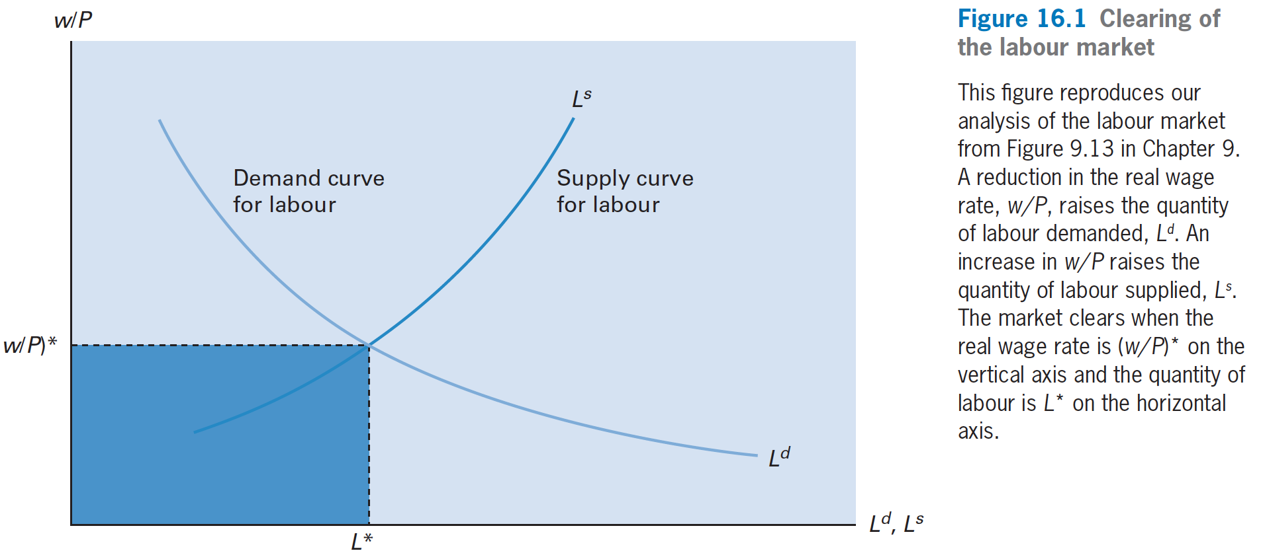
The Price-Misperceptions Model

Slide 10
The Price-Misperceptions Model
  The price level, P, a relevant variable being the price of a market basket of goods.
  These goods will be purchased from many locations at various times. Therefore, a worker will typically lack good current information about some of these prices.
  Denote by P^{e}, the price a worker expects to pay for a market basket of goods.

Slide 11
The Price-Misperceptions Model
  Suppose there happens an increase in the nominal quantity of money.
  What happens? when workers do not understand that an increase in the nominal wage rate, w, stems from a monetary expansion that inflates all nominal values, including the price level, P.

Slide 12
The Price-Misperceptions Model
  Each worker may think instead that the rise in w constitutes an increase in his or her real wage rate.
  The perceived real wage rate is the ratio of w to the expected price level, P^{e}. This ratio, w/P^{e}, rises if the expected price level, P^{e}, increases proportionately by less than w.
  If w/P^{e} increases, the worker increases the quantity of labor supplied, L^{s}.

Slide 13
The Price-Misperceptions Model
    w/P^{e} = (w/P)·(P/P^{e}), for a given actual real wage rate, w/P, an increase in P/P^{e} raises the perceived real wage rate, w/P^{e}.
  That is, if workers are under-estimating the price level, so that P^{e}< P, they must be over-estimating their real wage rate, w/P^{e} > w/P.

Slide 14
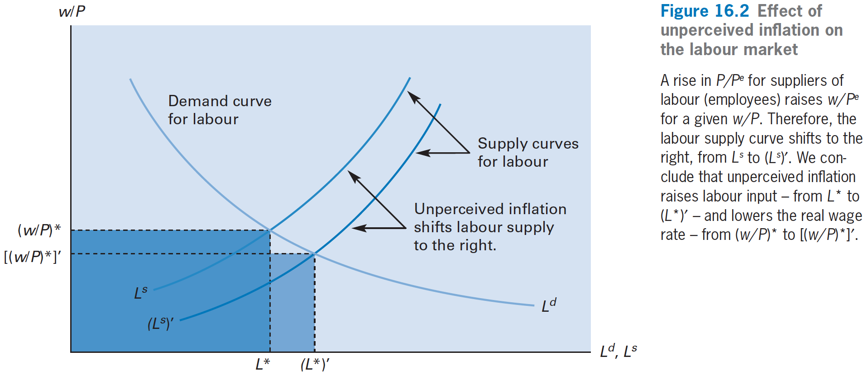
The Price-Misperceptions Model

Slide 15
The Price-Misperceptions Model
  Because of price misperceptions, the increase in P raises the quantity of labor supplied at a given w/P.
  An increase in the nominal quantity of money, M, that creates an unperceived rise in the price level affects the real economy and is, therefore, non-neutral.

Slide 16
The Price-Misperceptions Model
  Specifically, an increase in M raises the quantity of labor input, L.
  The rise in labor input, L, will lead to an expansion of production. That is, real GDP, Y, increases in accordance with the production function: Y= A· F(κK, L)

Slide 17
The Price-Misperceptions Model
  Money Is Neutral in the Long Run
    However, the expected price level, P^{e}, adjusts toward the actual price level, P, in the long run.
    The effects of an increase in the nominal quantity of money, M, on these real variables are only temporary. In the long run, an increase in M leaves the real variables unchanged.
    In the long run, the price level, P, and the nominal wage rate, w, rise by the same proportion as the increase in M.
    We conclude: in the long run, money is neutral.

Slide 18
The Price-Misperceptions Model
  Only Unperceived Inflation Affects Real Variables
    One important conclusion from the price-misperceptions model is that only unperceived changes in the price level, P, affect labor input, L, and real GDP, Y

Slide 19
The Price-Misperceptions Model
    If an increase in the nominal quantity of money, M, raises expected prices, P^{e}, in the short run by the same amount as actual prices, P, the monetary change will be neutral, just as we found for the long run.
    The reason is when P^{e} = P, workers understand the increase in their nominal wage rate, w, is due to a general increase in the nominal quantity of money, M, and the price level, P, and not to a rise in their real wage rate, w/P.

Slide 20
The Price-Misperceptions Model
  The Lucas Hypothesis on monetary shocks: the real effect of a given size monetary shock is larger, the more stable the underlying monetary environment.
  即：货币供给政策越稳定，预期不到的货币增发对实际GDP的影响就越大。

Slide 21
The Price-Misperceptions Model
Predictions for Economic Fluctuations
  Now we can use the price-misperceptions model to get alternative predictions of cyclical patterns for macroeconomic variables.
  In this analysis, we imagine that economic fluctuations result from monetary shocks, that is, exogenous variations in the nominal quantity of money, M.
  注意：之前economic fluctuations result from real shocks, A.

Slide 22
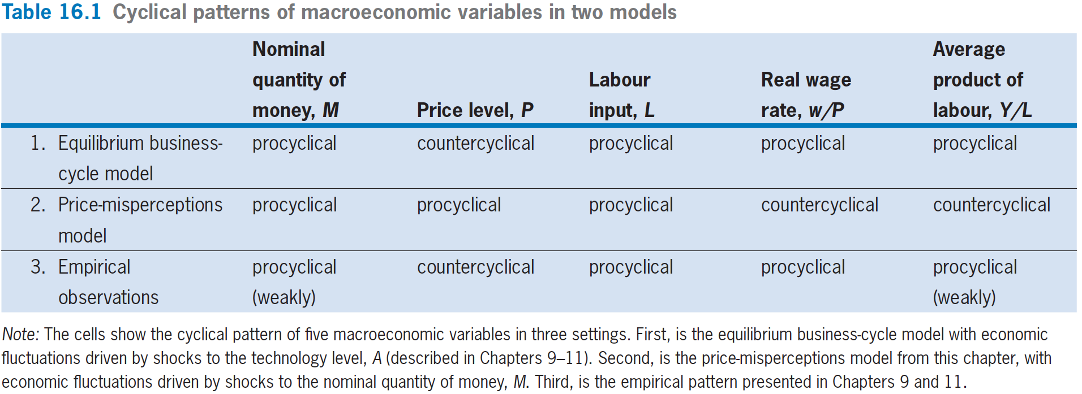
The Price-Misperceptions Model
1 is labor demand shifts rightward,
But 2 is labor supply shifts rightward, so w/p changes oppositely

Slide 23
The Price-Misperceptions Model
Empirical Evidence on the Real Effects of Monetary Shocks
  Some empirical evidence suggests that positive monetary shocks tend to expand the real economy, whereas negative monetary shocks tend to contract the real economy.
  However, the evidence is NOT 100% conclusive, and we surely lack reliable estimates of the strength of this relationship.

Slide 24
The Price-Misperceptions Model
Real Shocks
  How does price-misperceptions affect our previous analysis of a shock to the technology level, A.
    Increase in A raises real GDP, Y, but lowers price level, P, if the monetary authority holds constant the nominal quantity of money, M.
    We now assume, as in the price misperceptions model, that the expected price level, P^{e} , lags behind the actual price level, P.

Slide 25
The Price-Misperceptions Model
In a boom, when P declines, P^{e} decreases by less than P. Hence, P/P^{e} falls, that is, workers over-estimate P during a boom.
This over-estimate of P means that workers under-estimate their real wage rate: the perceived real wage rate, w/P^{e} , falls below w/P.
It follows that the quantity of labor supplied, L^{s} , decreases for a given w/P.

Slide 26
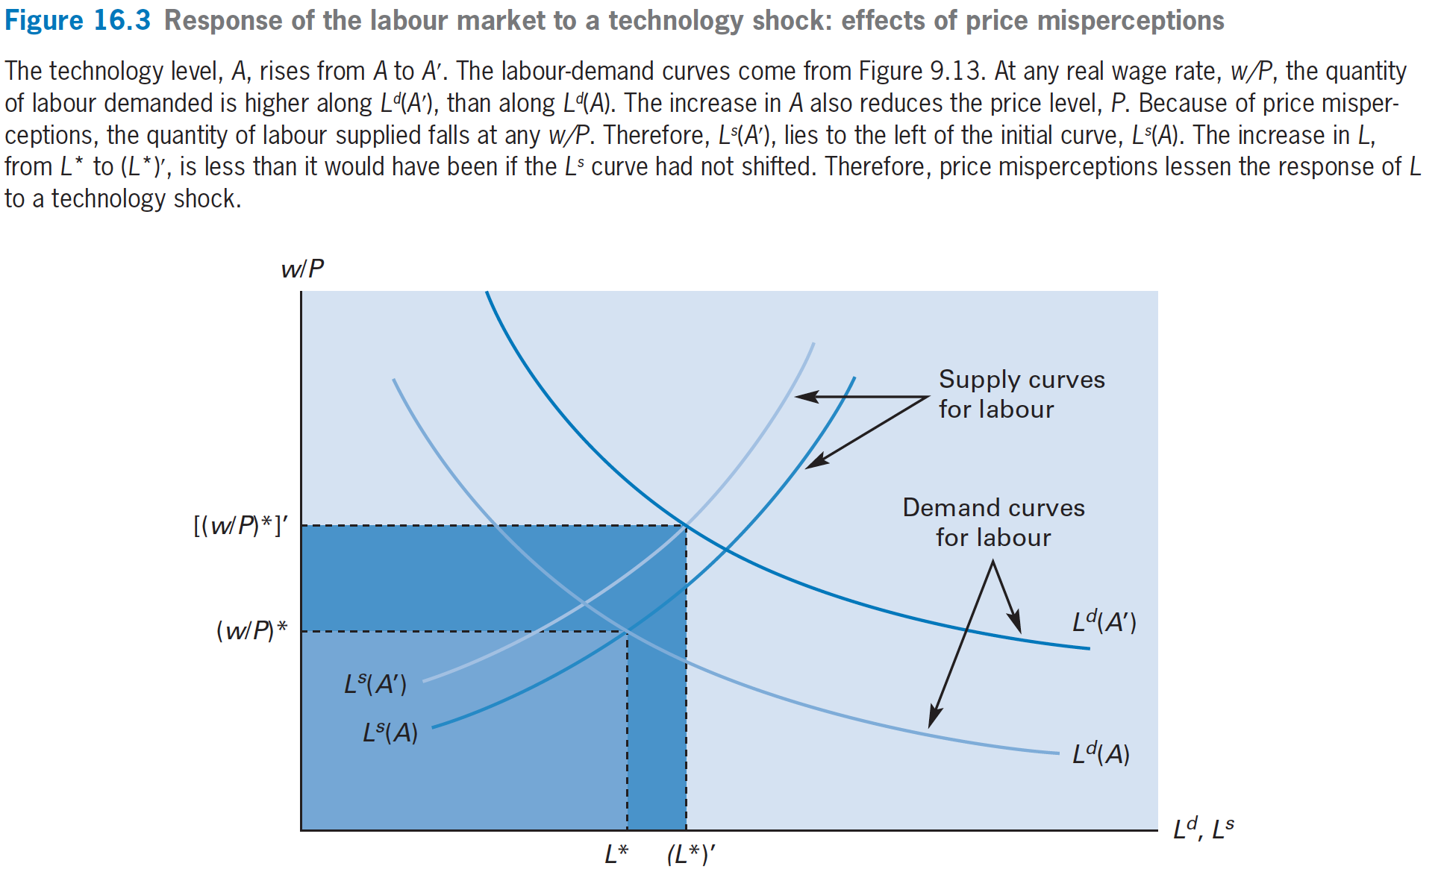
The Price-Misperceptions Model

Slide 27
The Price-Misperceptions Model
Summary of results for price-misperceptions model:
    Because of price misperceptions, unanticipated increases in the nominal quantity of money, M, raise real GDP, Y, and labor input, L, in the short run.
    Money was neutral in the model without price misperceptions in the long run.

Slide 28
The Price-Misperceptions Model
    However, price misperceptions lessen the short-run real effects of real shocks from the technology level, A.
    A favorable shock to the technology level, A, still raises Y and L, but by less than before.

Slide 29
Rules Versus Discretion

Slide 30
Rules Versus Discretion
Under a monetary rule, the central bank commits itself to a designated mode of conducting policy.
Under discretion（自由裁量）, the authority leaves open the possibility for surprises—that is, for monetary shocks.

Slide 31
Rules Versus Discretion
The real economy reacts to a change in the nominal quantity of money, M, only when the change is unanticipated—in particular, only when the money shocks causes the price level, P, to deviate from its perceived level, P^{e}.
Consequently, the monetary authority may be motivated to create price surprises as a way to affect real economic activity.

Slide 32
Rules Versus Discretion
For given inflationary expectations, π^{e}, the monetary authority faces a trade-off when considering whether to use its policy instruments to raise the inflation rate, π.
An increase in π is beneficial because it raises the inflation surprise, π − π^{e}, and thereby expands real GDP, Y, and labor input, L.

Slide 33
Rules Versus Discretion
However, the central banks in most advanced economies have become committed to low and stable inflation.
In many countries, the commitments are reinforced by formal provisions stipulating that the central bank’s objective is price stability.
With increasing frequency, this objective is stated in terms of inflation targeting.

Slide 34
